Slide 1
From ExPred to ExPerdVer2
A review of the paper
Aligning Faithful Interpretations with their Social Attribution
By: Zhang, Zijian

Slide 2
Content
The crisis of explanation-predict models
  Trojan Explanation
  Dominant Selection
  Loss of Performance
Causal attribution and Social attribution
The trinity of Explanation-Prediction-Verification
  Explanation-Prediction-Verification
  Contrastive Explanation
  Anecdotal examples
Conclusion/Critique/Insights

Slide 3
The crisis of ExPred, EP1: Trojan Explanation
What we think the models do:
The movie is good
_ movie _ good
POS
Explainer
Classifier
The movie is bad
The _ _ bad
NEG
Explainer
Classifier
What the models actually do:
The movie is good
A word on pos 2
POS
Explainer
Classifier
The movie is bad
No word on pos2
NEG
Explainer
Classifier

Slide 4
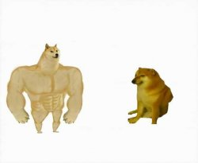
The crisis of ExPred, EP2: Dominant selection
The performance of Mr. X was not bad at all, it’s actually okay
The performance of Dr. Y was not bad at all, it’s actually okay foil:good
orig: bad
Dr. Y bad actually okay -> bad

Slide 5

The crisis of ExPred, EP3: Loss of performance
Evidence selection
Evidence selection
Partial input
Incomplete information

Slide 6





Causal attribution and social attribution
:
=
ExPred models
Causal attribution
Prediction
:
+
=
Human (according to social attribution theory¹)
Social attribution
Causal attribution
Cognition
1: https://www.sciencedirect.com/science/article/abs/pii/S0004370218305988?via%3Dihub

Slide 7
The trinity of Explanation-Prediction-Verification
POS
The movie is good
POS
The movie is good
The _ is good
POS
_ _ is good
POS
_ _ is _
???

Slide 8
The trinity of Explanation-Prediction-Verification
Prediction
The movie is good
POS
The _ is good
POS
Explanation
_ _ is good
POS
_ _ is _
???
Verification

Slide 9
Contrastive explanation
m_{p}
x:
The movie is not bad
POS
m_{p}(x)
Select heuristically
x’:
The movie is __ bad
NEG
≠ m_{p}(x)
The longest substring
x’_{c}:
The movie is not bad
POS
=m_{p}(x)
The shortest superstring

Slide 10
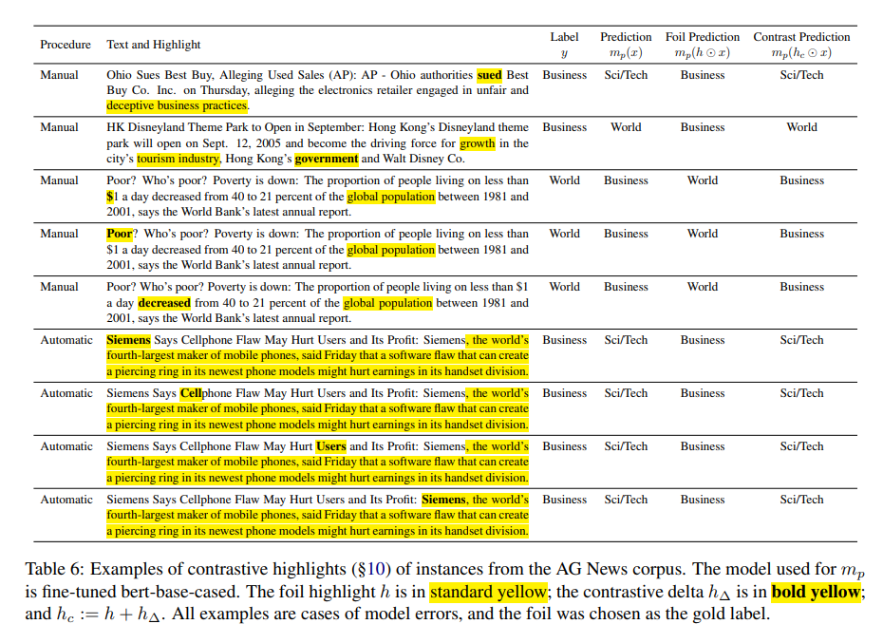
Anecdotal example

Slide 11
Conclusion/critique/insights
+ The selected part is not necessary the “evidence”, albeit subsequent models predict well
! The selection-prediction-verification schemata can serve as the foundation of our MTL structure
- The SPV schemata seems to have nothing to do with social attribution
- Algorithms/experiment evaluations are too empirical
- The “borderline” explanations are at most in length of 1 word
- Definition of “dominant selection” unclear:
  Can’t still differentiate overfitting to “bad” from “dominant selection”

